Slide 1
Ebay Web Search Demo
Kyle Elmore

Slide 2
Overview
Select ebay community forums to search
Crawl through forums for keywords in messages
Parse out keywords and upload to a database
Output results to Excel
Written in Python 3 using Selenium via Chrome

Slide 3
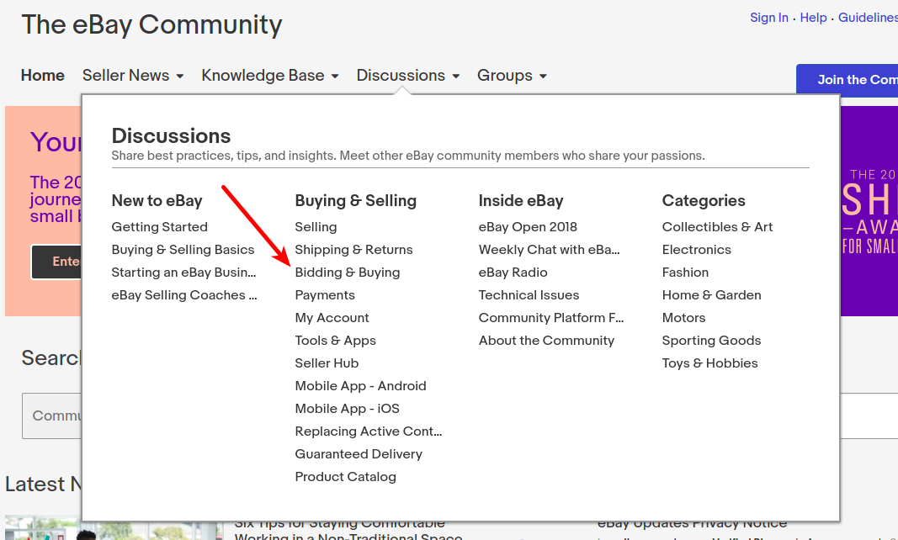
Ebay Listing Demo
Search for a board on ebay to be downloaded (can be any board)

Slide 4
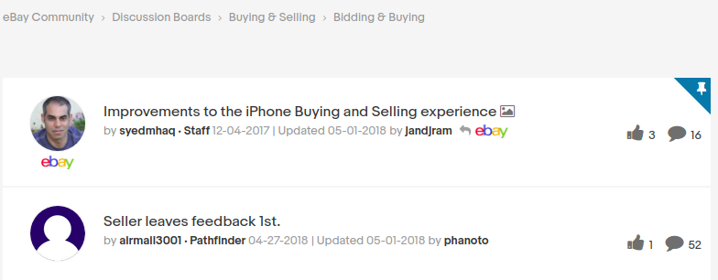
Select the board
Bidding & Buying demoed here

Slide 5
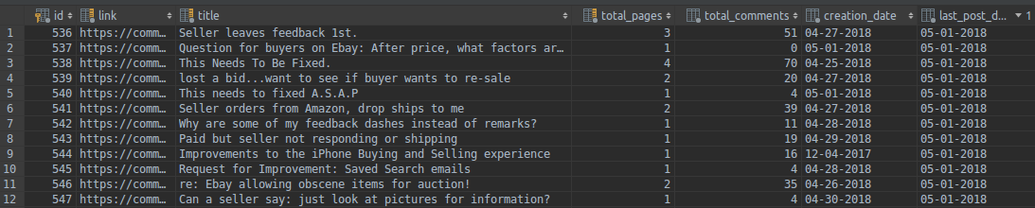
SQL Demonstration
Each post listing was saved to a database

Slide 6
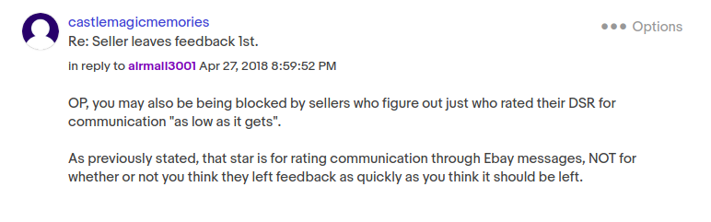
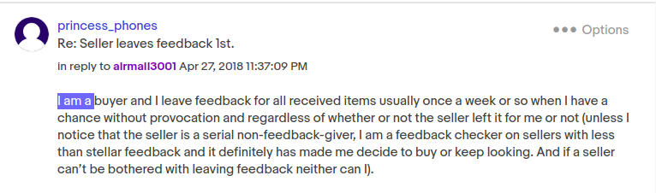
Examples of Messages
These will be downloaded to a database for parsing

Slide 7
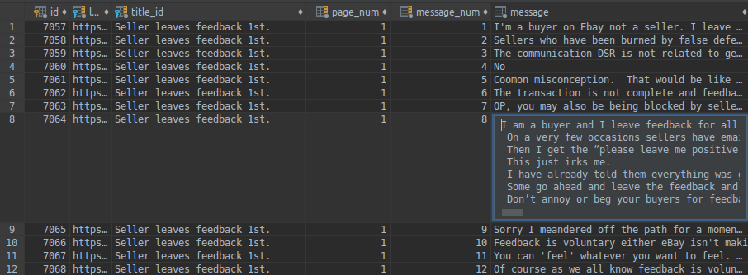
Messages Database
Each message saved to a database

Slide 8
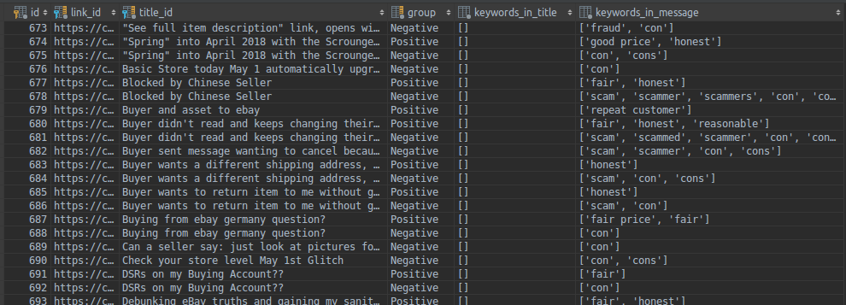
Keywords Parsing
The goal was to find keywords within each message, shown here

Slide 9
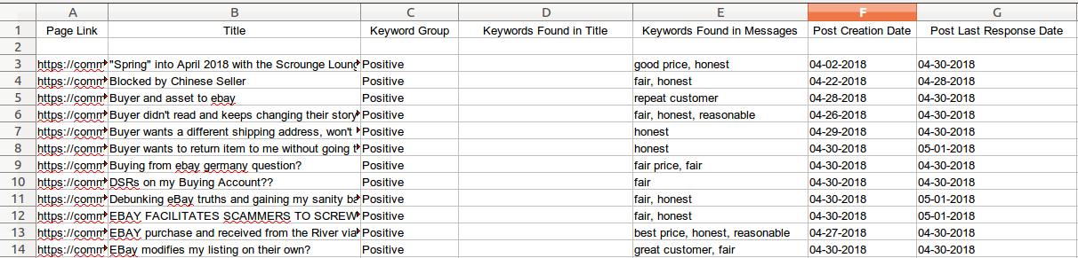
Output to Excel
All the data was gathered, formatted, and saved to Excel

Slide 10
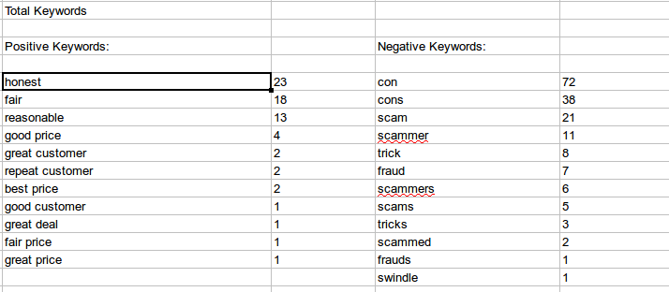
Excel - Word Count
The total keywords found was also outputted

Slide 11
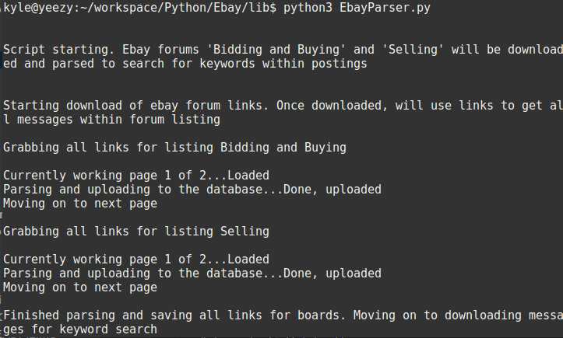
The Script Itself
Downloading the board listings

Slide 12
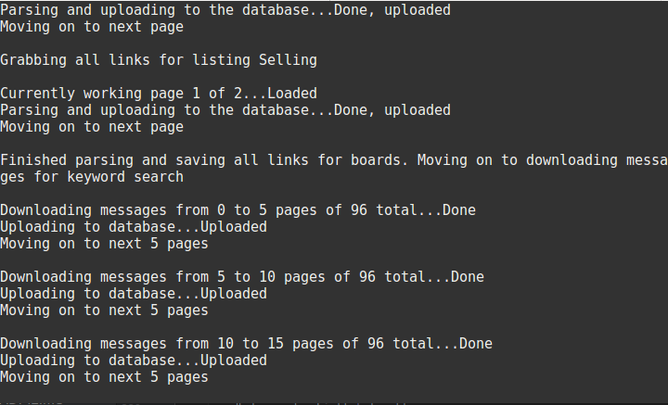
The Script Itself
Downloading messages

Slide 13
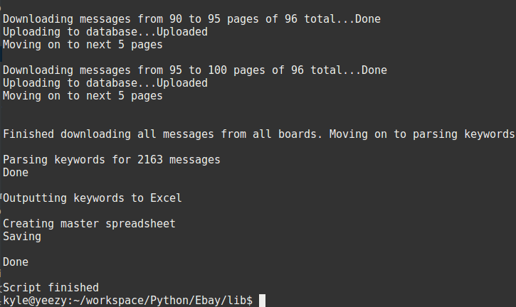
The Script Itself
Parsing keywords and outputting to Excel

